Slide 1
Intent of this presentation
Proposed audience:
Community leadership
Development Community
Contents:
Overview of SB24-005 (SB5)
Applications of SB5
Definitions of SB5
Landscape Alternatives Under SB5
Community Implications
How to use this presentation: customize the slide deck to best suit your needs. All language, pictures, and slides can be customized, however, text highlighted in yellow indicates specific areas that may need to be updated.
Thank you to the Colorado Water Conservation Board for providing the funding to make this resource possible!

Slide 2
Senate Bill 24-005 (SB5) Limits on Nonfunctional Turf
Limits on nonfunctional turf, nonfunctional artificial turf, and invasive species.

Slide 3
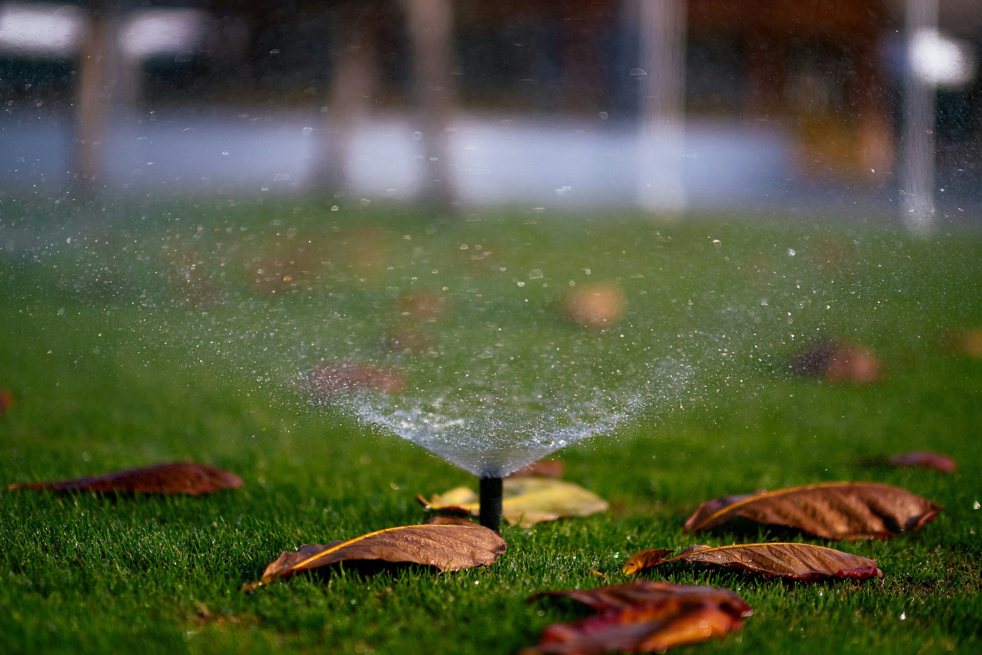
Senate Bill 24-005 (SB5) Overview
State legislation passed during the 2024 cycle
Prohibition of nonfunctional turf, nonfunctional artificial turf, and invasive plant species; applicable to certain new and redevelopment
Changes must be in place on and after January 1, 2026
Addresses impacts of climate change and increased water demands by limiting specific uses of water-intensive grass
https://leg.colorado.gov/bills/sb24-005
Photo by Mason Dahl on Unsplash
Notes:
SB stands for Senate Bill, 24 indicates it passed in 2024. 005 references the bill number.
The bill prohibits nonfunctional turf, artificial turf, and invasive plant species in specific applications, defined more specifically in later slides.
SB24-005 prohibited all artificial turf except for athletic fields. In 2025 HB25-1113 (HB = House bill) passed and changed this to prohibit only nonfunctional artificial turf (as defined in HB25-1113).
Communities must update their codes and processes to be compliant by January 1, 2026
The total of the bill is to address the impacts of climate change and increased water demands by limiting specific uses of water-intensive grass
More information can be found on the state’s website.

Slide 4
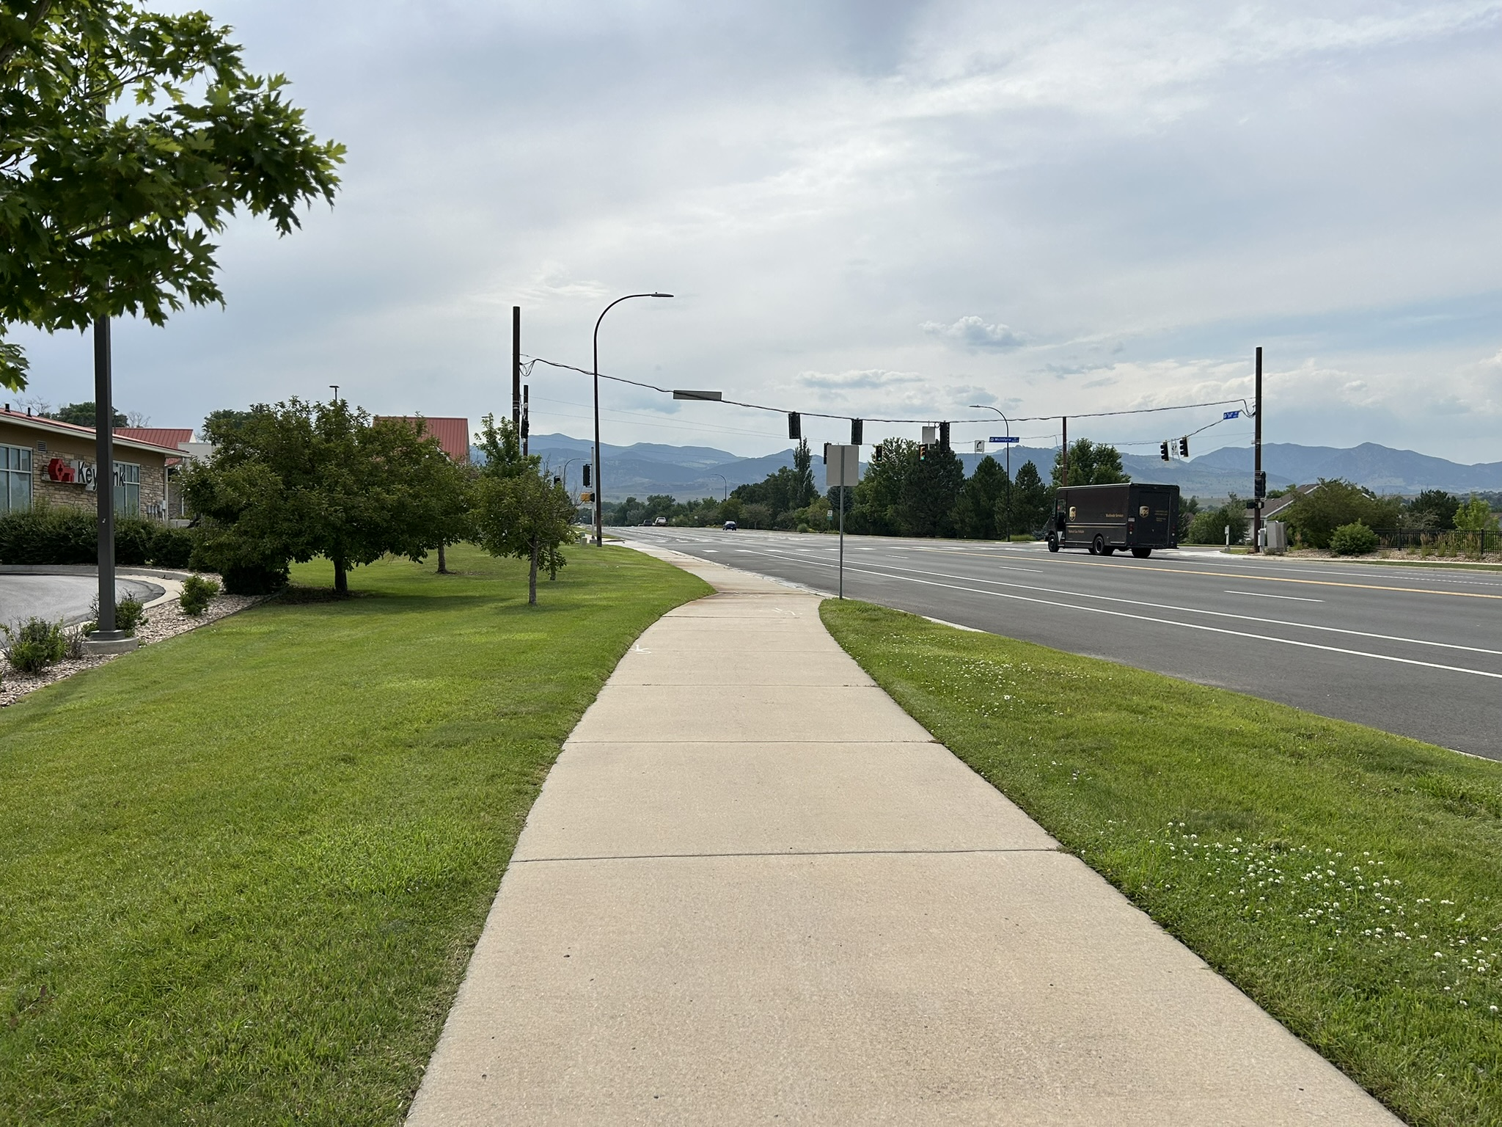
Applicable Development Under SB24-005
Applies to new development of commercial, institutional, industrial, common interest (HOA), street right-of-way, parking lot, medians, and transportation corridors, AND
Applies to redevelopment of the above categories
Applies when a permit or design review is submitted and over 50% of the total landscape area is disturbed.
Does not apply existing development
Does not apply to private residential lots*
*House Bill 25-1113, “Limit Turf in New Residential Development,” will extend SB5 requirements to new/redeveloped multifamily housing and will require some action to reduce turf in other new/redeveloped residential housing by 2028.
Notes:
SB24-005 applies to new development of commercial, institutional, industrial, common interest (HOA), street right of-way, parking lot, medians, and transportation corridors. This means it does not apply to any existing development, only new development and in some cases redevelopment.
Redevelopment, as defined by the bill, only applies when a permit or design review is submitted and over 50% of the total landscape area is disturbed.​ For redevelopment projects, only the disturbed portion of landscaping needs to be brought into compliance with SB24-005. Existing landscaping can remain the same.
Importantly this bill does not apply to private residential lots.
That said, a related house bill, HB25-1113 “Limit Turf in New Residential Development” passed in the 2025 legislative cycle that will extend SB24-005 requirements to new/redeveloped multifamily. Whie not the focus of the changes presented here, it will eventually require some action to reduce irrigation demands in other new/redeveloped residential by 2028.

Slide 5

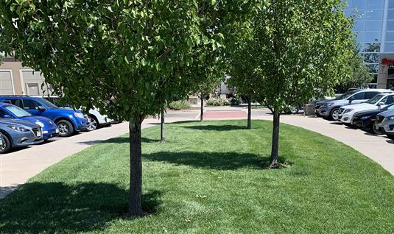
SB24-005 Terms Explained
Photo by Mason Dahl on Unsplash
Nonfunctional Turf/Artificial Turf
Functional Turf/Artificial Turf
Turf/artificial turf that is located in a recreational use area or other space that is regularly used for civic, community, or recreational purposes.
Examples: playgrounds, sports fields, picnic grounds, amphitheaters, portions of parks, golf courses
Turf/artificial turf that serves no practical use, provides no recreational benefits for the community, and is therefore purely aesthetic.
Examples: turf in between medians, street rights-of-way, parking lots, transportation corridors, lawn areas with no recreational purpose, and turf on steep slopes
Notes:
Functional as defined by the bill includes artificial turf/grass areas that are used for recreation. While it is up to individual communities to clarify what this means, common examples may include playgrounds, sports fields, picnic grounds, amphitheaters, portions of parks, golf courses
Nonfunctional turf/artificial turf, is turf that serves no practical use. Common examples include turf in between medians or large grassy lawn areas with no recreational purpose.

Slide 6
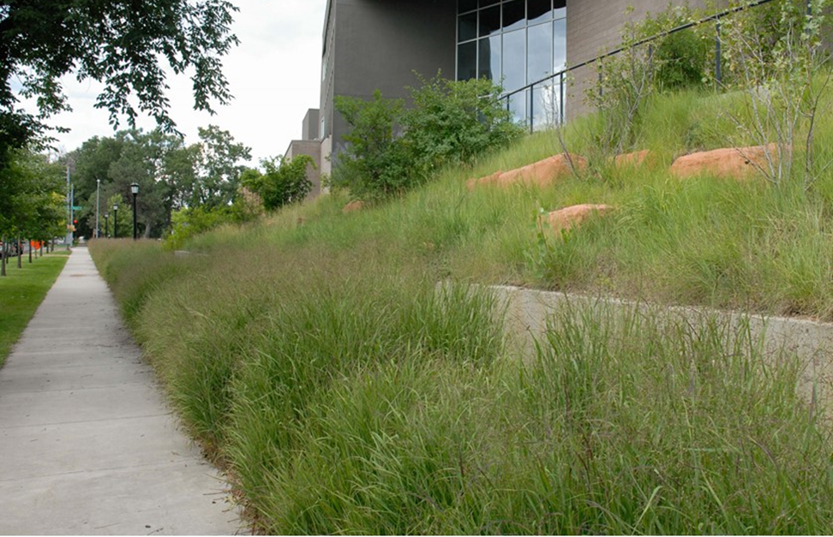
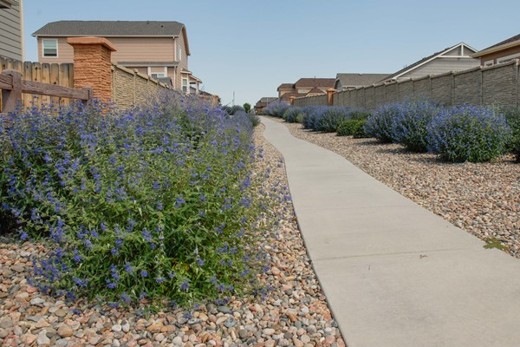
SB24-005 Alternative Landscape Options for Nonfunctional Turf Areas
Photo courtesy of Colorado Springs Utilities
Photo courtesy of Colorado Springs Utilities
Native, warm season, and climate adapted grasses
Water-wise plants
Notes:
If nonfunctional turf in certain scenarios is no longer permitted for new development, what is allowed instead?
In these spaces both native, warm season and climate adapted grasses and/or water-wise plants will be allowed.

Slide 7
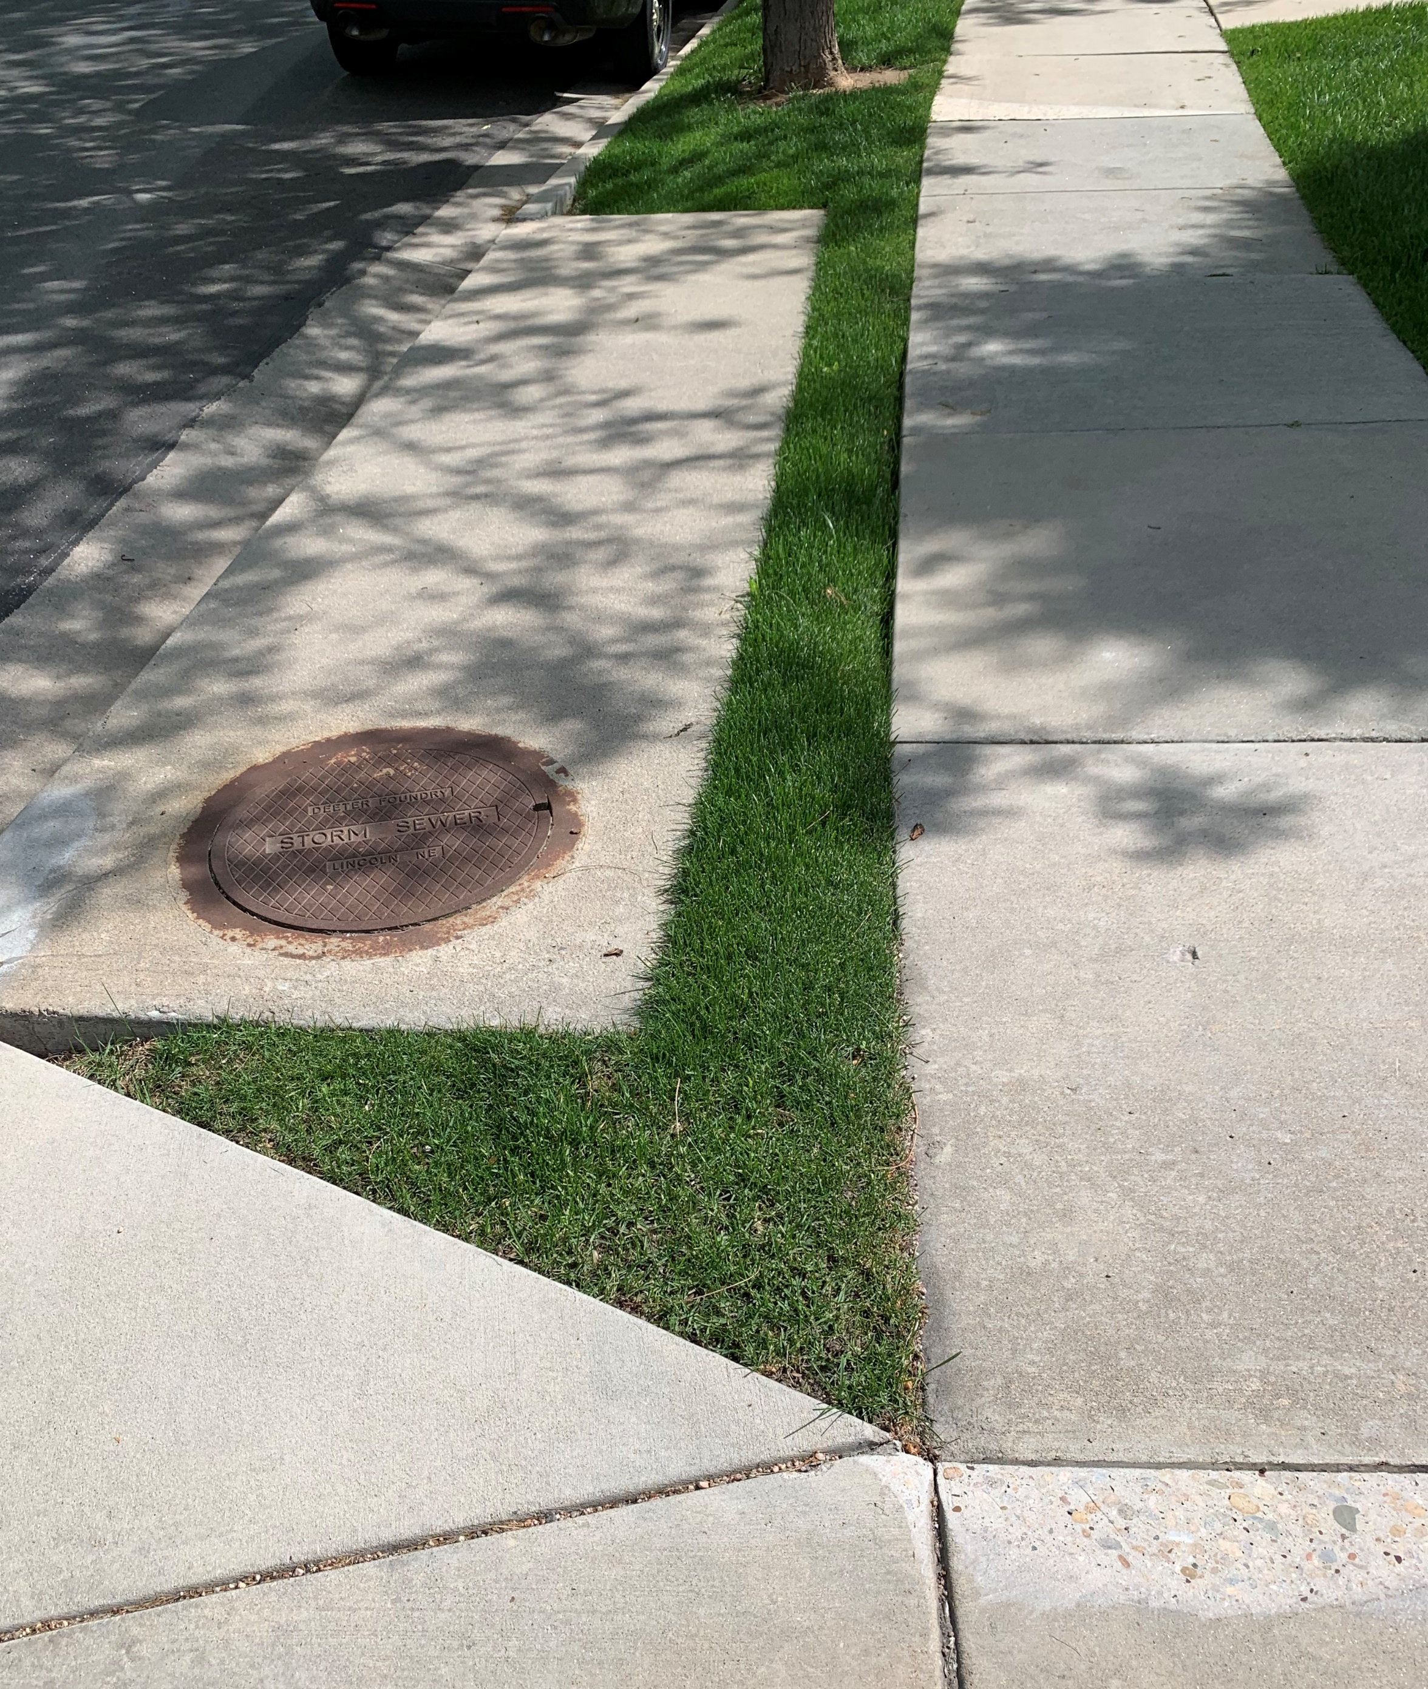
Necessary Changes
Update definitions to align with bill language
Update related documents and processes (e.g., development review process documents, plant lists, and review comments) to align with bill language
Other updates specific to your community
Notes:
So what does our community need to do to implement changes to be in compliance with SB24-005?
Town staff is working to:
Add applicable talking points based on staff actions.

Slide 8
Implications
Community Implications
Developer Implications
Staff
Implications
Aesthetic shifts in landscapes
Changing maintenance requirements
Water savings
Add
Different design and submittal requirements
Cost changes
Changing review processes
Notes:
What are the implications of this bill and the necessary changes to local code and resources?
Community
The community will see aesthetic shifts in landscapes – Less Kentucky bluegrass and more Bermuda grass and other native grasses and/or waterwise plants/flowers.
Maintenance of these landscapes can differ. Rather than simply driving a mower over the area weekly, it may require less frequent mowing, hand weeding or herbicide application.
The community will see water savings compared to nonfunctional turf. The native grass guidebook (https://coloradonativegrass.org/) states that native grass can use 1/3rd of traditional turf grass. Waterwise landscaping water savings depends significantly on the type of plants selected, but can use 30%-50% less water according to the CWW Best Practices Guidebook (https://coloradowaterwise.org/Best-Practices-Guidebook).
Developers
Developers also will experience change in the community – the landscape design will differ, submittal requirements may change to identify functional areas and uses and align definitions and plant lists, for example.
Costs for developers will also change. Compared to only installing turf, designing and seeding/planting native grasses and waterwise landscapes may have a different costs. In some cases it may be more expensive, in others it may be less.
Staff
From a community staff perspective, the review processes may require change to ensure compliance. Staff may require additional familiarity with the senate bill requirements, with native grasses, and waterwise landscapes.

Slide 9
Related Efforts
Opportunity to highlight any other community efforts, goals, or initiatives that may be supportive of SB24-005 changes. Examples potentially include:
Comprehensive plan goals/policies
Water-efficiency goals/policies
Strategic plan goals/policies
Opportunity to introduce House Bill 25-1113 (HB1113) and any efforts to include residential turf limitations

Slide 10
Questions for XXXXX?
What additional information would be helpful to fully understand SB24-005 and its requirements?
Are there specific aspects of the bill that you would like more clarity on?
Are there any concerns?

Slide 11
Questions?

Slide 12
Helpful Links and Resources
WesternResourceAdvocates.org/Community-Hub-Landscape-Transformation-Water-Conservation (see SB5 Compliance section)
ColoradoNativeGrass.org
Leg.Colorado.gov/Bills/sb24-005
Leg.Colorado.gov/Bills/hb25-1113
DLG.Colorado.gov/Land-Use-Codes
WaterNow.org/Our-Work/Our-Work-Projects/Project-Accelerator
SonoranInstitute.org/Card/GrowingWaterSmart

Slide 13
Examples of compliant code language
City of Aurora
City of Edgewater
No turf in medians, curbside landscapes, and golf courses
Turf is only allowed in active or programmed recreation areas on commercial properties, multifamily properties, schools, common areas, and parks properties
"Active or programmed recreation area" means an area with a primary function of sport field but can also accommodate secondary functions, including but not limited to, nonorganized sporting events, cultural activities, and organized social gatherings
No turf in front or side yards; shall not exceed the lesser of 45% or up to 500 square feet in backyards
(Section 138-191: use of turf and ornamental water features)
No turf in rights-of-way, medians, and parking lots.
Turf is only allowed in active or programmed recreation areas on commercial, industrial, and institutional properties.
No turf in areas less than 8 feet wide or on slopes greater than 25%.
Turf limited to 25% of total landscaped area on residential properties.
Artificial turf is prohibited.
(Chapter 16-34: water-efficient landscaping requirements)
Notes:
Some examples of what compliant code language looks like in current community landscape codes

Slide 14
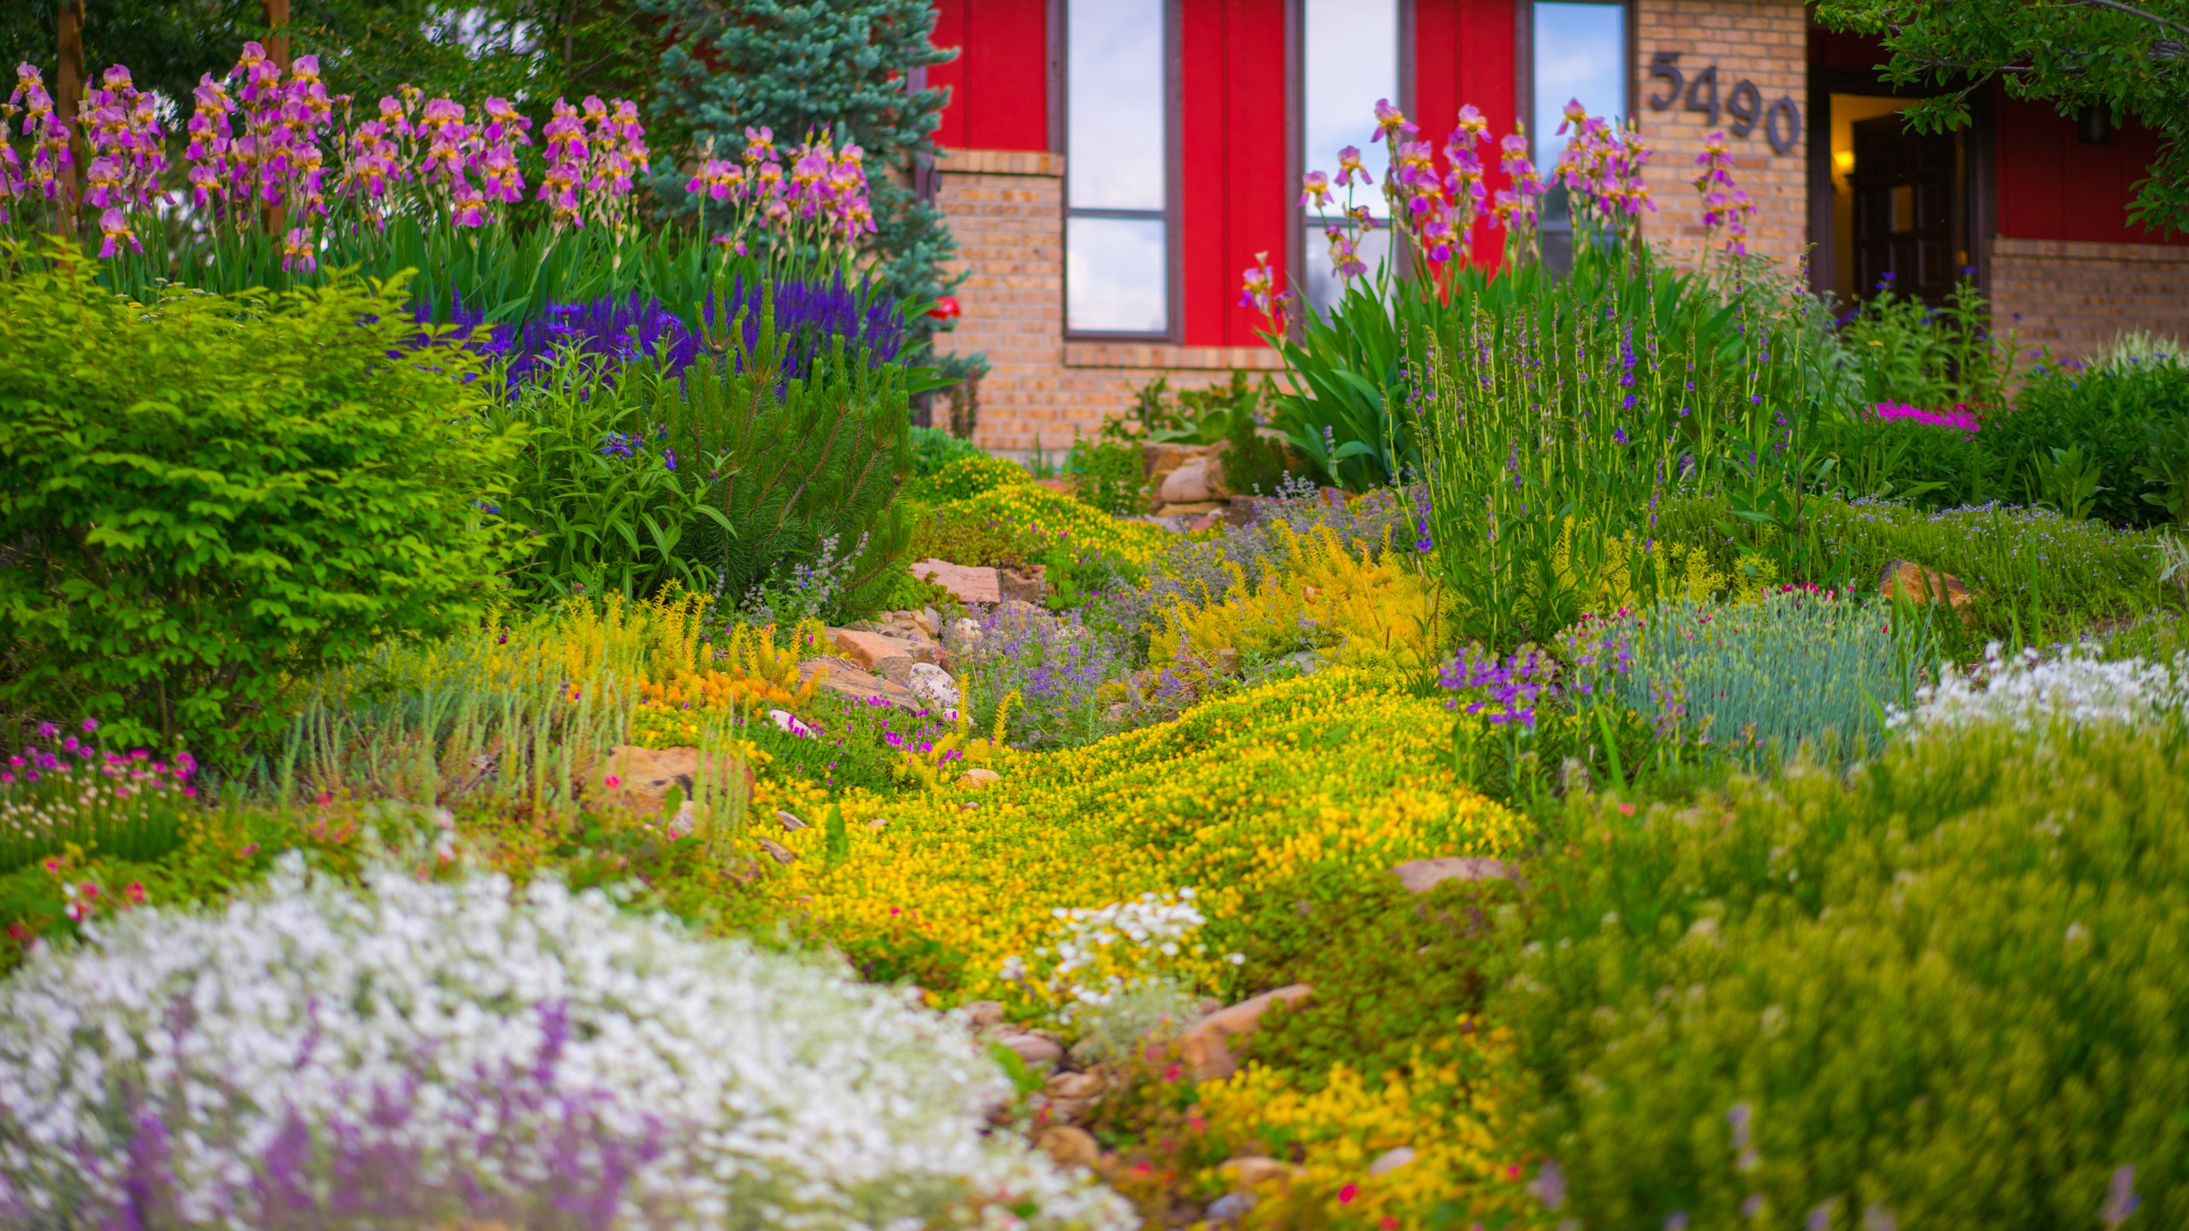
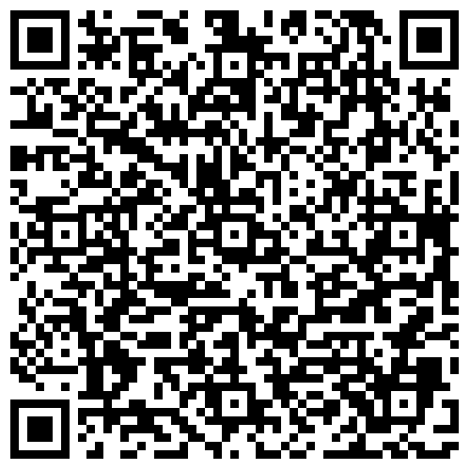



Interested in SB24-005 implementation resources? Scan the QR Code
Photo courtesy of Resource Central

