Slide 1
A Path to Pollution-Free Buildings
August 3, 2023

Slide 2
Reminders
Time
Recording
Questions

Slide 3
THANK YOU TO
OUR SPONSORS
Impact sponsor: FirstBank
Premier sponsors: Sol-Up, Vision Ridge Partners
Signature sponsors: SCARPA, SWEEP, Torch Clean Energy

Slide 4
Stacy Tellinghuisen
Deputy Director of Policy Development

Slide 5
Introduction
Colorado has ambitious, science-based economy-wide emissions reduction goals
Residential and commercial buildings account for 16% of energy-related emissions in the state.
Notes:
TPs:
Colorado set ambitious economy-wide emission reduction goals of 26% by 2025, 50% by 2030, and 100% by 2050, all below 2005 levels. In 2023, the Colorado legislature also established emission goals for interim years between 2030 and 2050.
The state has made significant progress in certain sectors, namely electricity. Most of Colorado’s electric utilities have plans to reduce their emissions by 80% below 2005 levels by 2030. This is critical, because we can leverage progress in the electric sector to electrify other sectors, like transportation and buildings.
Today we’re focusing on residential and commercial buildings, which represent approximately 16% of Colorado’s energy-related emissions. Emissions from these buildings primarily stems from burning natural gas for space- and water-heating. For example, in residences, space and water heating account for 93% of natural gas use.
Decarbonizing energy use in buildings is critical to meeting our economy-wide emission goals, which brings me to the legislation Colorado passed to address emissions from gas utilities.

Slide 6
Introduction
In 2021, Colorado passed SB 264, the Clean Heat Standard
Sets emission reduction goals for gas utilities: 4% reduction by 2025 and 22% reduction by 2030, below 2015 levels.
Covers emissions from customers’ end use and methane leakage on the distribution system.
Eligible resources include
Energy efficiency
Beneficial electrification
Green hydrogen
Recovered methane
Pyrolysis of tires
Wastewater thermal energy
Any technology that the Commission finds is cost-effective, and that the Division finds results in a reduction in carbon emissions from the combustion of gas in customer end uses or meets a recovered methane protocol…
Xcel filed its first clean heat plan on August 1
Notes:
TPs:
In 2021, the Colorado legislature passed nation-leading legislation in Senate bill 264, which established a clean heat standard for gas utilities. Under the legislation, gas utilities have a goal of reducing emissions 4% by 2025 and 22% by 2030, relative to 2015 levels.
Those goals cover emissions from customers end use and methane leakage on the distribution system.
The legislation established a suite of eligible measures, listed here.
Through 2022, the PUC held an extensive rulemaking to establish the rules for utilities to file clean heat plans. Xcel filed its first clean heat plan on August 1.
WRA, SWEEP, and NRDC worked over the past 6 months to develop our analysis and report, A Path to Pollution-Free Buildings, with the goal of identifying the suite of strategies needed to meet Xcel’s 2030 emission goals. We wanted to understand the level of appliance adoption and utility investment needed to achieve the emission reduction goals. The analysis finds that two clean heat resources – energy efficiency and beneficial electrification- can achieve the needed reductions, though this requires robust utility programming and a market transformation.
Again, as I noted earlier, decarbonizing energy use in buildings is critical to meeting our economy-wide emission goals. And because appliances like furnaces have a long lifetime, it is critical to start now.
Today, our panelists will discuss the details of the analysis, including what is required to meet the 2030 goals; the cost-effectiveness of different clean heat resources; and how we can best deploy these measures in a way that promotes equity, improves air quality, and ensures low- and moderate-income customers benefit from this transition.

Slide 7
Dr. Asa Hopkins
Vice President
Lorena Gonzalez
Communities and Justice Campaign Manager
Meera Fickling
Senior Policy Advisor
Notes:
JAMES:
If you are contacted directly, please loop in MarComm. In Colorado, several of you already have good relationships with reporters who will contact you directly. Even in these cases, it's important to give your program comms manager a heads-up that a reporter has approached you.
MarComm will help to determine if the reporter, story and publication are a good fit. In most cases, the comms managers have relationships with reporters or familiarity with outlets, and we will use our knowledge to help you best
prepare for interviews. Also, there can be coalition dynamics that may play into how we respond to the media and what we say. This is more common in Nevada, where comms leads work together in an organized coalition.
We want an optimal forum to get your message out clearly.
That means knowing the angle of the piece. Again, this is an area where your team's comms manager can help tremendously. We often work with reporters on story ideas and angles, and in those instances where a story comes to us organically – not as the result of a pitch or outreach – we want to make sure that we're giving the reporter what they need.
Sometimes that means passing to a partner organization. In particular, we may want EJ partners to take the lead as spokespeople on issues that directly effect their communities the most.
We want to be strategic with our interviews – its quality, not quantity. Earlier this year, the MarComms team developed a list of targeted news outlets – these are the priorities for messaging.

Slide 8
Meera Fickling
Western Resource Advocates
Key findings and takeaways from the report
Notes:
JAMES:
If you are contacted directly, please loop in MarComm. In Colorado, several of you already have good relationships with reporters who will contact you directly. Even in these cases, it's important to give your program comms manager a heads-up that a reporter has approached you.
MarComm will help to determine if the reporter, story and publication are a good fit. In most cases, the comms managers have relationships with reporters or familiarity with outlets, and we will use our knowledge to help you best
prepare for interviews. Also, there can be coalition dynamics that may play into how we respond to the media and what we say. This is more common in Nevada, where comms leads work together in an organized coalition.
We want an optimal forum to get your message out clearly.
That means knowing the angle of the piece. Again, this is an area where your team's comms manager can help tremendously. We often work with reporters on story ideas and angles, and in those instances where a story comes to us organically – not as the result of a pitch or outreach – we want to make sure that we're giving the reporter what they need.
Sometimes that means passing to a partner organization. In particular, we may want EJ partners to take the lead as spokespeople on issues that directly effect their communities the most.
We want to be strategic with our interviews – its quality, not quantity. Earlier this year, the MarComms team developed a list of targeted news outlets – these are the priorities for messaging.

Slide 9
Meeting the clean heat targets requires a market transformation of HVAC and water heating over the next 7 years. We can do this by:
Prioritizing replacing ACs, gas furnaces, and gas water heaters at end of life with efficient electric appliances
Accelerating gas efficiency savings
Frontloading spending to stimulate workforce development and customer education
Providing robust incentives for low-income households

Slide 10
The Challenge

Slide 11
Why electrification and efficiency?
Space and water heating account for over 90% of gas usage in homes in the Mountain West.
Efficiency and electrification are complementary
Opportunities to replace gas appliances at end of life with electric alternatives
Other resources like hydrogen and renewable natural gas (RNG) are limited in their use in buildings, and very expensive.

Slide 12
Electric replacements for gas appliances increase as a percentage of annual appliance sales
 | 2023 | 2024 | 2025 | 2026 | 2027 | 2028 | 2029 | 2030
Residential Multifamily Space Heating | 2% | 4% | 8% | 15% | 20% | 25% | 35% | 35%
Residential Single Family Space Heating | 2% | 4% | 8% | 15% | 20% | 25% | 35% | 35%
Residential Water Heating | 2% | 8% | 17% | 28% | 42% | 55% | 65% | 75%
Residential Central Air Conditioning | 2% | 8% | 20% | 33% | 50% | 75% | 100% | 100%
Residential Cooking | 2% | 8% | 15% | 30% | 45% | 60% | 75% | 80%

Slide 13
Electrification drives most of the reduction in gas sales in our portfolio, but efficiency plays a role

Slide 14
Incentives
Appliance | 2024 | 2025 | 2026 | 2027 | 2028 | 2029 | 2030
SFR cold climate HP | $4,000 | $4,000 | $3,500 | $3,000 | $2,500 | $2,000 | $2,000
SFR standard HP replacing AC | $1,500 | $1,000 | $1,000 | $500 | $300 | $ - | $ -
SFR cold climate HP – IQ Customers | $24,000 | $24,000 | $24,000 | $24,000 | $24,000 | $24,000 | $24,000
HP water heater with smart controls | $800 | $800 | $800 | $600 | $600 | $400 | $400
HP water heater w/o smart controls | $600 | $600 | $400 | $200 | $200 | $ - | $ -
HP water heater with smart controls - IQ Customers | $3,900 | $3,900 | $3,900 | $3,900 | $3,900 | $ 3,900 | $3,900
All-electric new home | $10,000 | $6,000 | $6,000 | $3,000 | $2,000 | $ - | $ -

Slide 15
Complementary policies
Contractor outreach and training: make incentives as easy as possible to access
Market heat pumps to customers and make them as easy as possible to finance
Appliance standards and building codes
Require two-way ACs (heat pumps) by 2029
Invest in low-income households (at least 20% of budget)

Slide 16
Budget

Slide 17
Benefits of our portfolio
Gas infrastructure savings: $51 million in 2030 (conservative estimate)
Social cost of avoided carbon: $200 million in 2030
Improved home comfort, air quality, and cooling access
Market transformation reduces incentives needed after 2030 (but still continues to reduce emissions!)

Slide 18
Dr. Asa Hopkins
Synapse Energy Economics
Modeling the
cost analysis and data
Notes:
JAMES
More info is not better – you can easily overwhelm, confuse or lose your audience with too much detail
Remember, the public knows less than you think – start with the basic
Avoid jargon and acronyms
Short and simple is best – not more than 30 seconds

Slide 19
Costs and Emission Reduction Potential of Building Heat Decarbonization Options
Summary of analysis completed for Western Resource Advocates
August 3, 2023
Asa Hopkins
(on behalf of Kenji Takahashi, Ellen Carlson, Philip Eash-Gates, Kyle Schultz, and Paul Rhodes)

Slide 20
About Synapse
Founded in 1996 by CEO Bruce Biewald
Leader for public interest and government clients in providing rigorous analysis of the energy sector
Staff of 40+ includes experts in energy, economic, and environmental topics

Slide 21
Decarbonization Options: Cost, Potential, Emissions
Electrification
Utility cost based on incentives for heat pump and HPWH purchase
Potential limited by stock turnover rates/equipment lifetimes
Emissions reduction from equipment efficiency and falling electric grid emissions
Renewable Natural Gas
Utility cost based on incremental fuel cost
Potential limited by regional resource availability
Emissions reduction depends on blend of feedstocks
Green Hydrogen
Utility cost based on incremental fuel cost; shaped by IRA tax incentives
Potential limited by blend limits for pipeline and consumer equipment
10% by volume, ramping up from 0% over time
Emissions reduction from assumed zero-emission fuel
 | Levelized cost of emissions reduction ($/ton)
Heat Pumps | $95*
RNG | $234
Green H₂ | $247
*: Value for Xcel scenarios; varies between states/utilities

Slide 22
Annual Utility Cost of Avoided Emissions by Resource

Slide 23
Scenarios: Xcel Gas, Colorado
Scenario 1: High Electrification and Low Alternative Fuels
Scenario 2: Moderate Electrification and High Alternative Fuels
Scenarios achieve comparable emission reductions by 2040, while prioritizing different resources
Not intended to reflect state-policy-specific compliance pathways

Slide 24
Annual Average Utility Cost of Avoided Emissions by Scenario

Slide 25
Lorena Gonzalez
Conservation Colorado
Public Health, Community Benefits, & Environmental Justice

Slide 26
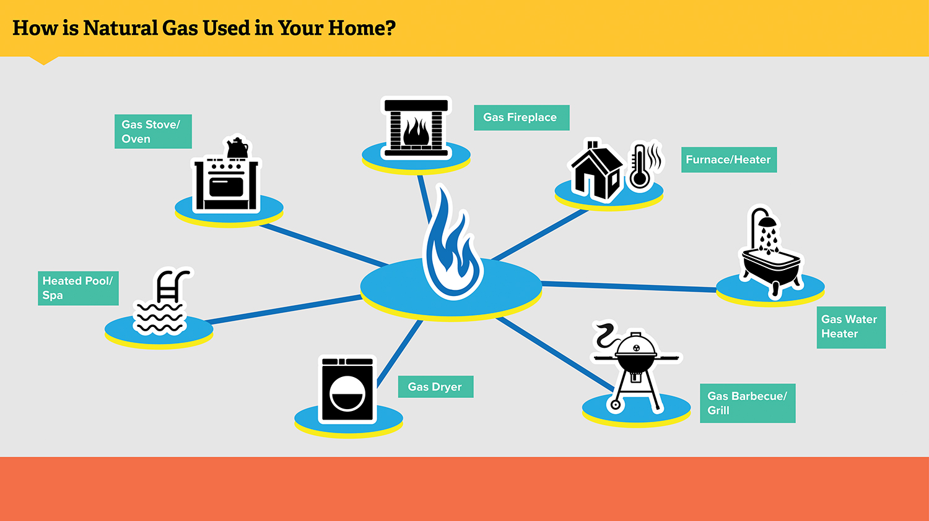
Natural Gas & Public Health
The main ingredient of natural gas is methane: a planet-warming gas that can negatively impact our health
Natural gas-powered appliances such as furnaces, boilers, and water heaters can release air pollutants that cause dangerous indoor air pollution and endanger respiratory health
Americans spend more than 90 percent of their time indoors where concentrations of some pollutants can range from two to five times as high as outdoor concentrations (EPA)
Natural gas produces the byproduct of nitrogen dioxide which can reduce lung function, cause inflammation of airways, increase asthma attacks, and worsen other respiratory issues. It’s also known to harm children’s respiratory tract and cognitive development.

Slide 27
Community Benefits of Making Homes More Efficient & Electric
Swapping gas appliances for electric ones and implementing building energy efficiency measures can help facilitate healthy and safe indoor air quality
Electrification can reduce heating bills; that benefit increases when efficiency upgrades are paired with electrification
30% of Denver residents do not have air conditioning – heat pumps can help households access AC during increasingly hot summers
Moving toward electrification and energy efficiency won’t undermine our climate pollution reduction goals

Slide 28
Environmental Justice & Equity Must be Centered in the Transition to Clean Heat
Historical clean energy measures have disproportionately benefited higher-income households
Barriers to address:
Public education & outreach
Upfront costs of new electric appliances or required home renovations
Ensuring renters can benefit from electrification and energy efficiency measures
That’s why it’s crucial that Xcel and the PUC ensure there are strategic and robust incentives as well as on-bill financing for low- and moderate-income households

Slide 29
Justin Brant
Utility Program Director
Kiki Velez
Equitable Gas Transition Advocate
Notes:
JAMES:
If you are contacted directly, please loop in MarComm. In Colorado, several of you already have good relationships with reporters who will contact you directly. Even in these cases, it's important to give your program comms manager a heads-up that a reporter has approached you.
MarComm will help to determine if the reporter, story and publication are a good fit. In most cases, the comms managers have relationships with reporters or familiarity with outlets, and we will use our knowledge to help you best
prepare for interviews. Also, there can be coalition dynamics that may play into how we respond to the media and what we say. This is more common in Nevada, where comms leads work together in an organized coalition.
We want an optimal forum to get your message out clearly.
That means knowing the angle of the piece. Again, this is an area where your team's comms manager can help tremendously. We often work with reporters on story ideas and angles, and in those instances where a story comes to us organically – not as the result of a pitch or outreach – we want to make sure that we're giving the reporter what they need.
Sometimes that means passing to a partner organization. In particular, we may want EJ partners to take the lead as spokespeople on issues that directly effect their communities the most.
We want to be strategic with our interviews – its quality, not quantity. Earlier this year, the MarComms team developed a list of targeted news outlets – these are the priorities for messaging.

Slide 30
Thank you for joining!
Watch for the recording in your inbox in the next few days and links to other resources.
Interested in supporting WRA’s clean heat work and other on-the-ground solutions to climate change? Visit:
WesternResourceAdvocates.org/donate

